Slide 1
Programming for problem solving
Presented by,
Devipriya M
Assistant professor
SRM IST Trichy

Slide 2
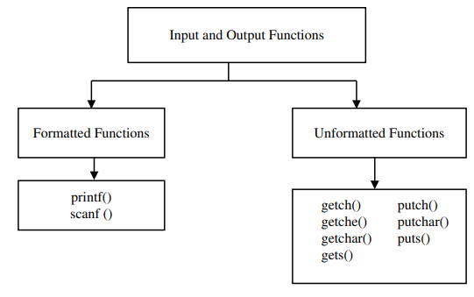
Input/ Output Functions

Slide 3
Printf and scanf
printf(“String and format specifier",argument_list);
The format specifier can be %d (integer), %c (character), %s (string), %f (float) etc.
scanf("format string", &argument);
printf() and scanf() functions are declared in “stdio.h” header file in C library.
All syntax in C language including printf() and scanf() functions are case sensitive.

Slide 4
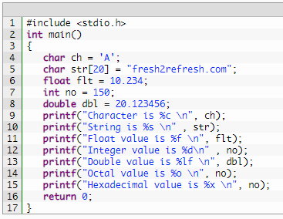
Printf

Slide 5
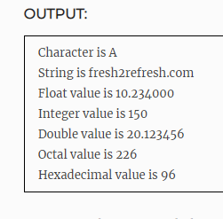
Printf

Slide 6
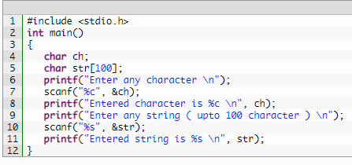
Scanf

Slide 7
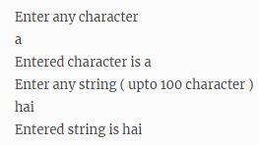
Scanf

Slide 8
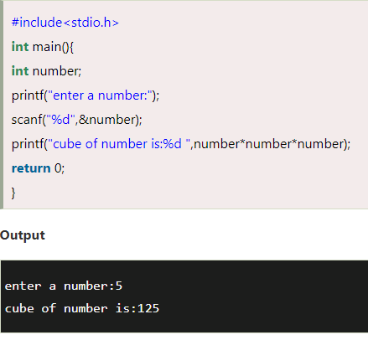
Printf and scanf

Slide 9
Printf and Scanf
The scanf("%d",&number) statement reads integer number from the console and stores the given value in number variable.
The printf("cube of number is:%d ",number*number*number)
statement prints the cube of number on the console.

Slide 10
Unformatted Functions
getchar() and putchar()
These two functions help in reading a character from the standard input unit (usually a keyboard) and writing it to the standard output unit (usually a screen).
getchar(): Reads a character from the standard input device.
putchar(): Writes a character to the standard output device.

Slide 11
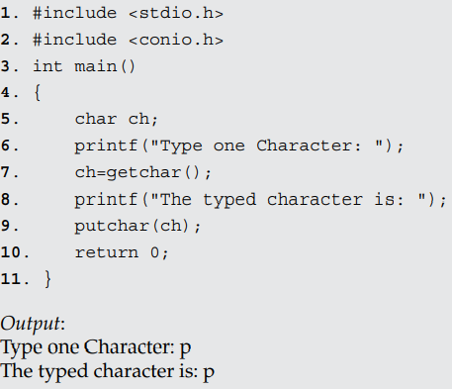
Unformatted Functions

Slide 12
Unformatted Functions
gets() and puts()
These two functions help in reading a string from the standard input unit (usually a keyboard) and writing it to the standard output unit (usually a screen).
gets() reads a string from the standard input device. It accepts the name of a string as a parameter input from the keyboard.
puts() writes a string to the standard output device. It accepts the name of a string and displays the accepted string on the screen.

Slide 13
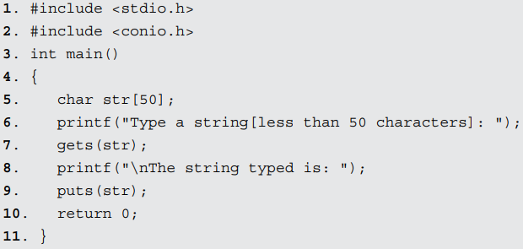

Slide 14
Arithmetic Operators
There are two types of arithmetic operators. These are (i) binary operator and (ii) unary operator.
Binary Operator
These operators are commonly used in most of the computer languages. These arithmetic operators are used for numerical calculations between the two constant values. They are also called Binary Arithmetic Operators. Binary operators are those operators which require two operands.
Unary Operators:
The operators which require only one operand are called unary operators. Unary operators are increment operator (++), decrement (– –) and minus (–).

Slide 15
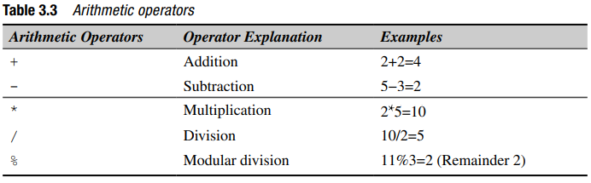

Slide 16
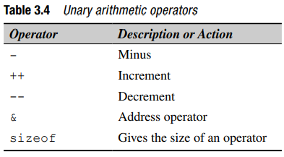

Slide 17
If ‘++’ or ‘--’ are used as a suffix to the variable name, then post-increment/ decrement operations take place. Consider an example for understanding the ‘++’ operator as a suffix to the
variable.
x=20;
y=10;
z=x*y++;
In the above equation, the current value of y is used for the product. The result is 200, which is assigned to ‘z’. After multiplication the value of y is incremented by one.

Slide 18
If ‘++’ or ‘——’ are used as a prefix to the variable name, then pre increment/ decrement operations take place. Consider an example for understanding ‘++’ operator as a prefix to the variable.
x=20;
y=10;
z=x*++y;
In the above equation, the value of y is incremented and then multiplication is carried out. The result is 220, which is assigned to ‘z’. The following programs can be executed for verification of increment and decrement operations.

Slide 19
The sizeof operator gives the bytes occupied by a variable, i.e. the size in terms of bytes required in memory to store the value. The number of bytes occupied varies from variable to variable depending upon its data types.
The ‘&’ operator gives the address of the variable in the memory.

Slide 20
Relational operator
These operators are used to distinguish between two values depending on their relations.
These operators provide the relationship between two expressions. If the relation is true then it returns a value 1 otherwise 0 for false.

Slide 21
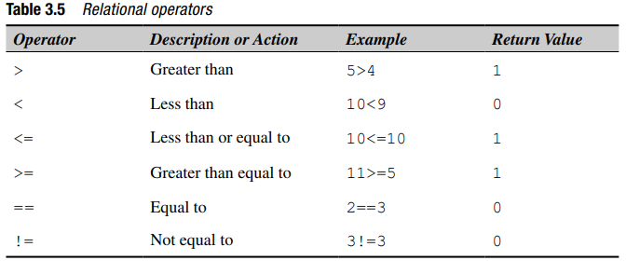

Slide 22
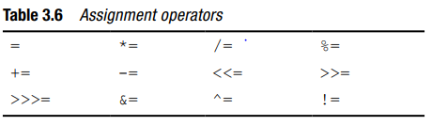
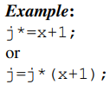
Assignment Operators and Expressions
Assigning a value to a variable is very simple. For example, int x=5; here, 5 is assigned to x and this is carried out by the operator =.
The equal sign (=) is used for assignment and hence, the name assignment operator has been given.

Slide 23
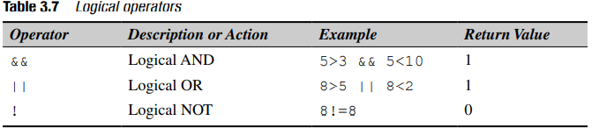
Logical Operators
The logical relationship between the two expressions is tested with logical operators. Using these operators, two expressions can be joined. After checking the conditions, it provides logical true (1) or false (0) status.
The operands could be constants, variables and expressions.

Slide 24
The logical AND (&&) operator provides true result when both expressions are true, otherwise 0.
The logical OR (||) operator provides true result when one of the expressions is true, otherwise 0.
The logical NOT operator (!) provides 0 if the condition is true, otherwise 1.

Slide 25
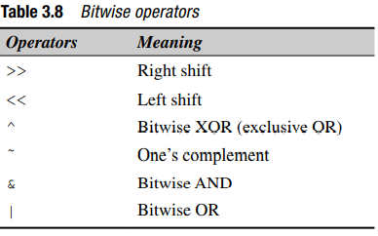
Bitwise Operator
C supports six bit operators. These operators can operate only on integer operands such as int, char, short and long.

Slide 26


If x=8
before right shift
After right shift
n is the number, s is the number of shifts and y is the result.

Slide 27
Expressions
An expression is a combination of operators, constants and variables. An expression may consist of one or more operands, and zero or more operators to produce a value.
There are 4 types of expressions:
Arithmetic expressions
Relational expressions
Logical expressions
Conditional expressions

Slide 28
Conditional expressions
A conditional expression is an expression that returns 1 if the condition is true otherwise 0.
A conditional operator is also known as a ternary operator.
exp1 ? exp2 : exp3.

Slide 29
lvalue simply means an object that has an identifiable location in memory (i.e. having an address).
r-value simply means, an object that has no identifiable location in memory.

Slide 30
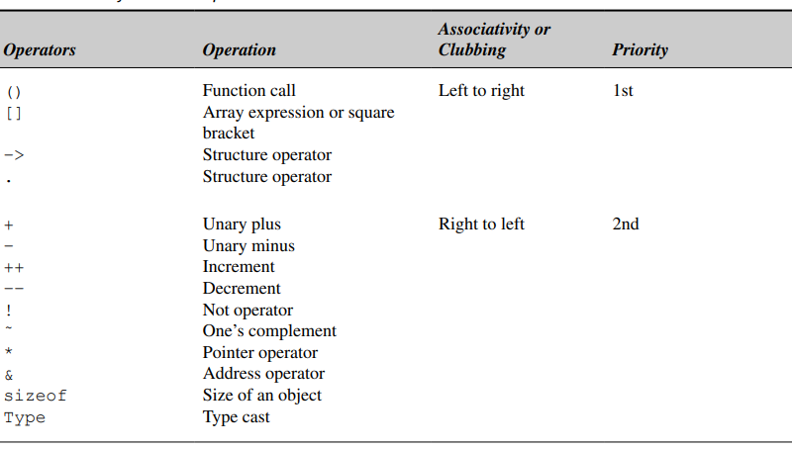
Operator precedence and associativity

Slide 31
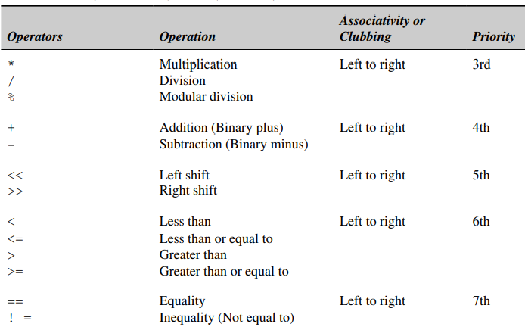
Operator precedence and associativity

Slide 32
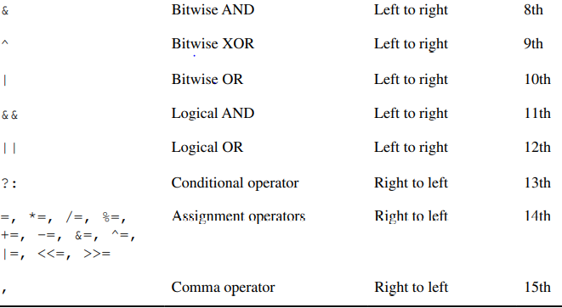
Operator precedence and associativity

Slide 33
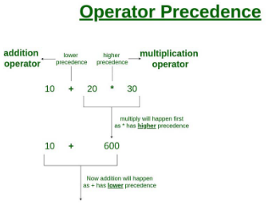
Precedence

Slide 34
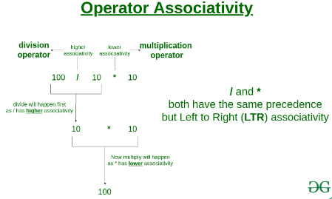
associativity

Slide 35
Expressions in c
#include <stdio.h>
int main(){
//Arithmetic Expression
int a = (6 * 2) + 7 - 9;
printf("The arithmetic expression returns: %d\n", a);
//Relational Expression
int b = 10;
printf("The relational expression returns: %d\n", b % 2 == 0);
//Logical Expression
int c = (7 > 9) && ( 5 <= 9);
printf("The logical expression returns: %d\n", c);
//Conditional Expression
int d = (34 > 7) ? 1 : 0;
printf("The conditional expression returns: %d\n", d);
//Pointer Expression
int e = 20;
int *addr = &e;
printf("The pointer expression returns: %p\n", addr);
//Bitwise Expression
int f = 10;
int shift = 10 >> 1;
printf("The bitwise expression returns: %d\n", shift);
return 0;
}

Slide 36
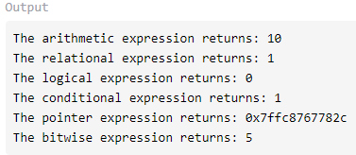
Output of expressions in c

